Slide 1
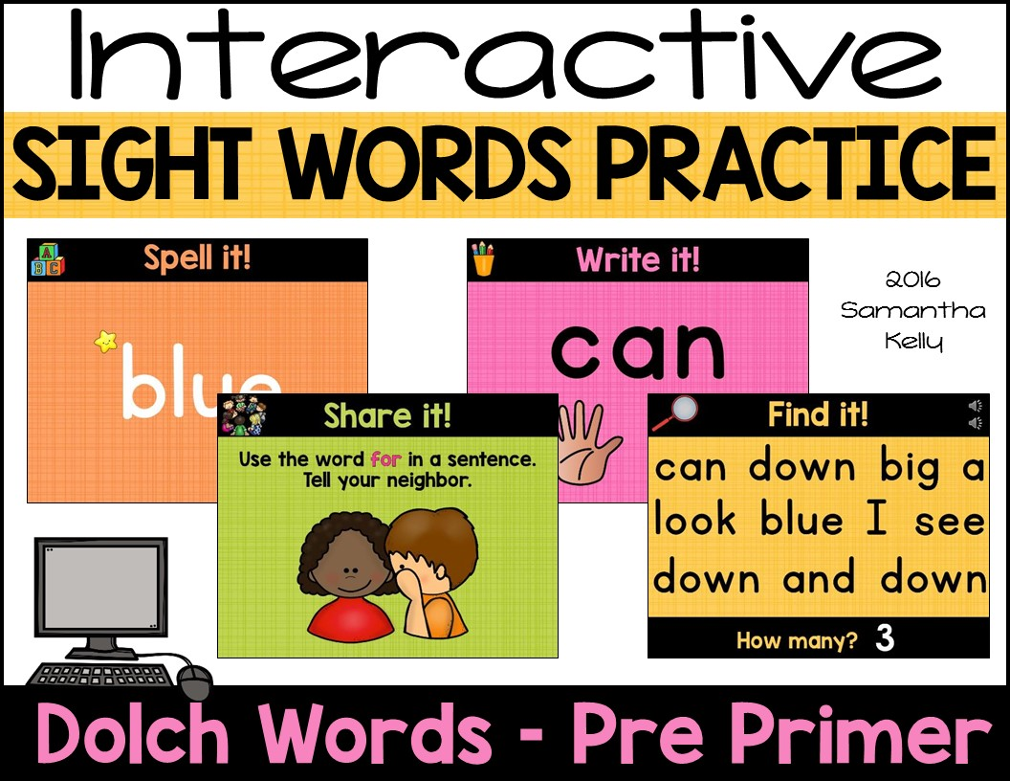

Slide 2
Using this Resource
Step 1: Download and install the following FREE fonts from TPT. You NEED them for formatting. Right click and choose Open Hyperlink. After installing the fonts, completely shut down and restart PowerPoint.
  KG Blank Space Solid
  KG Primary Penmanship 2
Step 2: Choose a set from the Table of Contents and scroll to its start page.
Step 3: Switch to Performance Mode (use one of the following ways)
  Click Slide Show Tab -> Choose From Current Slide
  Press Shift and f5 at the Same Time
Step 4: Connect to your projector so students can view from the screen.
Step 5: Use a clicker or the spacebar of your keyboard to click through each of the actions on the slideshow. Click here to view the video tutorial for using this set Right click and choose Open Hyperlink.

Slide 3
Table of Contents
4-12: a
13-21: and
22-30: away
31-39: big
40-48: blue
49-57: can
58-66: come
67-75: down
76-84: find
85-93: for
94-102: funny
103-111: go
112-120: help
121-129: here
130-138: I
139-147: in
148-156: is
157-165: it
166-174: jump
175-183: little
184-192: look
193-201: make
202-210: me
211-219: my
220-228: not
229-237: one
238-246: play
247-255: red
256-264: run
265-273: said
274-282: see
283-291: the
292-300: three
301-309: to
310-318: two
319-327: up
328-336: we
337-345: where
346-354: yellow
355-363: you

Slide 4

Let’s
learn a
word!

Slide 5



a
2016 Samantha Kelly

Slide 6



Spell it!
a
2016 Samantha Kelly

Slide 7


2
0
1
3
4
Find it!
5
Press space to start timer.
a
the
at
my
see
a
can
a
go
for
a
blue
4
How many?

Slide 8




a
Write it!
Write it on your hand.
Write it in the air.
2016 Samantha Kelly

Slide 9






Read it!
I see a dog.
I have a hat.
A pig is pink.
2016 Samantha Kelly

Slide 10



Move it!
Spell the word out loud and do a push up for every letter!
a
2016 Samantha Kelly

Slide 11



Share it!
Use the word a in a sentence.
Tell your neighbor.
2016 Samantha Kelly

Slide 12


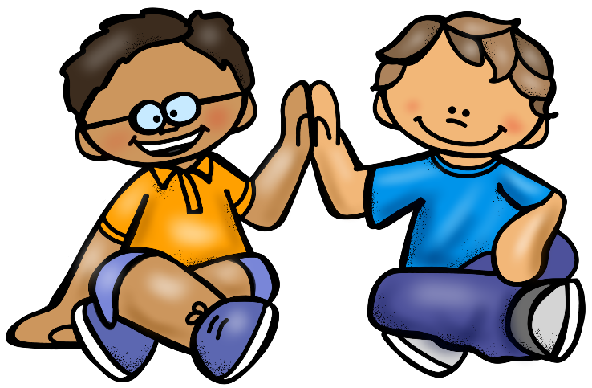
Woohoo!
We know the word
a!

Slide 13
Let’s
learn a
word!

Slide 14
and
2016 Samantha Kelly

Slide 15
Spell it!
a
n
d
2016 Samantha Kelly

Slide 16
2
0
1
3
4
Find it!
5
Press space to start timer.
I
and
me
and
is
the
and
for
and
to
my
and
5
How many?

Slide 17
Write it!
and
Write it on your hand.
Write it in the air.
2016 Samantha Kelly

Slide 18











Read it!
I like milk and cookies.
I have a dog and cat.
A bug is black and red.
2016 Samantha Kelly

Slide 19

Move it!
Spell the word out loud and do a squat for every letter!
a
d
n
2016 Samantha Kelly

Slide 20
Share it!
Use the word and in a sentence.
Tell your neighbor.
2016 Samantha Kelly

Slide 21
Woohoo!
We know the word
and!

Slide 22
Let’s
learn a
word!

Slide 23
away
2016 Samantha Kelly

Slide 24
Spell it!
a
w
a
y
2016 Samantha Kelly

Slide 25
2
0
1
3
4
Find it!
5
Press space to start timer.
you
is
away
I
in
away
up
we
look
big
away
3
How many?

Slide 26
away
Write it!
Write it on your hand.
Write it in the air.
2016 Samantha Kelly

Slide 27




Read it!
Put the blocks away.
Do not run away!
The duck flew away.
2016 Samantha Kelly

Slide 28

Move it!
Spell the word out loud and run in place for every letter!
a
a
w
y
2016 Samantha Kelly

Slide 29
Share it!
Use the word away in a sentence.
Tell your neighbor.
2016 Samantha Kelly

Slide 30
Woohoo!
We know the word
away!

Slide 31
Let’s
learn a
word!

Slide 32
big
2016 Samantha Kelly

Slide 33
Spell it!
b
i
g
2016 Samantha Kelly

Slide 34
2
0
1
3
4
Find it!
5
Press space to start timer.
big
look
big
up
can
big
two
big
jump
a
big
my
5
How many?

Slide 35
Write it!
big
Write it on your hand.
Write it in the air.
2016 Samantha Kelly

Slide 36




Read it!
I see a big horse.
I have a big sister.
The tree is big!
2016 Samantha Kelly

Slide 37

Move it!
Spell the word out loud and do a jumping jack for every letter!
b
i
g
2016 Samantha Kelly

Slide 38
Share it!
Use the word big in a sentence.
Tell your neighbor.
2016 Samantha Kelly

Slide 39
Woohoo!
We know the word
big!

Slide 40
Let’s
learn a
word!

Slide 41
blue
2016 Samantha Kelly

Slide 42
Spell it!
b
l
u
e
2016 Samantha Kelly

Slide 43
2
0
1
3
4
Find it!
5
Press space to start timer.
play
a
the
blue
for
it
blue
me
blue
here
find
3
How many?

Slide 44
Write it!
blue
Write it on your hand.
Write it in the air.
2016 Samantha Kelly

Slide 45



Read it!
I have a blue shoe.
My pencil is blue.
Look at the blue sky!
2016 Samantha Kelly

Slide 46

Move it!
Spell the word out loud and do a lunge for every letter!
b
u
l
e
2016 Samantha Kelly

Slide 47
Share it!
Use the word blue in a sentence.
Tell your neighbor.
2016 Samantha Kelly

Slide 48
Woohoo!
We know the word
blue!

Slide 49
Let’s
learn a
word!

Slide 50
can
2016 Samantha Kelly

Slide 51
Spell it!
c
a
n
2016 Samantha Kelly

Slide 52
2
0
1
3
4
Find it!
5
Press space to start timer.
and
not
can
to
can
jump
is
can
come
can
little
4
How many?

Slide 53
Write it!
can
Write it on your hand.
Write it in the air.
2016 Samantha Kelly

Slide 54




Read it!
I can read.
Can you paint?
A fish can swim.
2016 Samantha Kelly

Slide 55

Move it!
Spell the word out loud and touch your elbow to your knee for every letter!
a
c
n
2016 Samantha Kelly

Slide 56
Share it!
Use the word can in a sentence.
Tell your neighbor.
2016 Samantha Kelly

Slide 57
Woohoo!
We know the word
can!

Slide 58
Let’s
learn a
word!

Slide 59
come
2016 Samantha Kelly

Slide 60
Spell it!
c
o
m
e
2016 Samantha Kelly

Slide 61
2
0
1
3
4
Find it!
5
Press space to start timer.
come
I
help
it
can
the
a
come
away
come
we
3
How many?

Slide 62
Write it!
come
Write it on your hand.
Write it in the air.
2016 Samantha Kelly

Slide 63

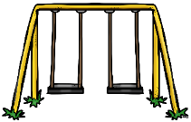

Read it!
Come to my house.
Can you come swing?
Come here, kitten!
2016 Samantha Kelly

Slide 64

Move it!
Spell the word out loud and do a push up for every letter!
o
m
e
c
2016 Samantha Kelly

Slide 65
Share it!
Use the word come in a sentence.
Tell your neighbor.
2016 Samantha Kelly

Slide 66
Woohoo!
We know the word
come!

Slide 67
Let’s
learn a
word!

Slide 68
down
2016 Samantha Kelly

Slide 69
Spell it!
d
o
w
n
2016 Samantha Kelly

Slide 70
2
0
1
3
4
Find it!
5
Press space to start timer.
can
down
big
a
look
blue
I
see
down
and
down
3
How many?

Slide 71
Write it!
down
Write it on your hand.
Write it in the air.
2016 Samantha Kelly

Slide 72


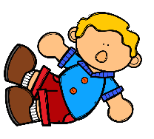
Read it!
Can you sit down?
Go down the slide!
I fell down.
2016 Samantha Kelly

Slide 73

Move it!
Spell the word out loud and do a squat for every letter!
w
o
n
d
2016 Samantha Kelly

Slide 74
Share it!
Use the word down in a sentence.
Tell your neighbor.
2016 Samantha Kelly

Slide 75
Woohoo!
We know the word
down!

Slide 76
Let’s
learn a
word!

Slide 77
find
2016 Samantha Kelly

Slide 78
Spell it!
f
i
n
d
2016 Samantha Kelly

Slide 79
2
0
1
3
4
Find it!
5
Press space to start timer.
find
blue
down
me
find
a
away
find
go
is
find
4
How many?

Slide 80
Write it!
find
Write it on your hand.
Write it in the air.
2016 Samantha Kelly

Slide 81



Read it!
Find the cat!
Did you find a bug?
I can’t find my sock.

Slide 82
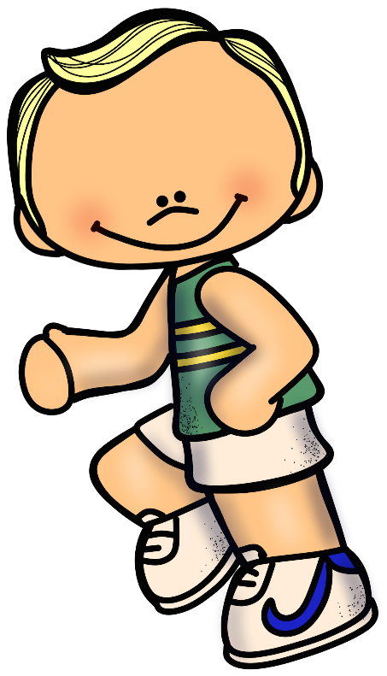
Move it!
Spell the word out loud and run in place for every letter!
f
n
i
d
2016 Samantha Kelly

Slide 83
Share it!
Use the word find in a sentence.
Tell your neighbor.
2016 Samantha Kelly

Slide 84
Woohoo!
We know the word
find!

Slide 85
Let’s
learn a
word!

Slide 86
for
2016 Samantha Kelly

Slide 87
Spell it!
f
o
r
2016 Samantha Kelly

Slide 88
2
0
1
3
4
Find it!
5
Press space to start timer.
help
for
to
for
it
for
you
play
for
run
the
for
5
How many?

Slide 89
Write it!
for
Write it on your hand.
Write it in the air.
2016 Samantha Kelly

Slide 90



Read it!
The gift is for you.
It is time for lunch!
Look for the car.
2016 Samantha Kelly

Slide 91

Move it!
Spell the word out loud and do a jumping jack for every letter!
r
o
f
2016 Samantha Kelly

Slide 92
Share it!
Use the word for in a sentence.
Tell your neighbor.
2016 Samantha Kelly

Slide 93
Woohoo!
We know the word
for!

Slide 94
Let’s
learn a
word!

Slide 95
funny
2016 Samantha Kelly

Slide 96
Spell it!
f
y
u
n
n
2016 Samantha Kelly

Slide 97
2
0
1
3
4
Find it!
5
Press space to start timer.
red
two
funny
little
in
big
and
funny
down
my
2
How many?

Slide 98
Write it!
funny
Write it on your hand.
Write it in the air.
2016 Samantha Kelly

Slide 99




Read it!
I see a funny clown.
My dad is funny.
Is it a funny monster?
2016 Samantha Kelly

Slide 100

Move it!
Spell the word out loud and do a lunge for every letter!
n
u
n
f
y
2016 Samantha Kelly

Slide 101
Share it!
Use the word funny in a sentence.
Tell your neighbor.
2016 Samantha Kelly

Slide 102
Woohoo!
We know the word
funny!

Slide 103
Let’s
learn a
word!

Slide 104
go
2016 Samantha Kelly

Slide 105
Spell it!
g
o
2016 Samantha Kelly

Slide 106
2
0
1
3
4
Find it!
5
Press space to start timer.
go
come
go
me
can
go
see
go
go
away
go
is
6
How many?

Slide 107
go
Write it!
Write it on your hand.
Write it in the air.
2016 Samantha Kelly

Slide 108



Read it!
We go to school.
Did you go to sleep?
Go up the stairs.
2016 Samantha Kelly

Slide 109

Move it!
Spell the word out loud and touch your elbow to your knee for every letter!
o
g
2016 Samantha Kelly

Slide 110
Share it!
Use the word go in a sentence.
Tell your neighbor.
2016 Samantha Kelly

Slide 111
Woohoo!
We know the word
go!

Slide 112
Let’s
learn a
word!

Slide 113
help
2016 Samantha Kelly

Slide 114
Spell it!
h
e
l
p
2016 Samantha Kelly

Slide 115
2
0
1
3
4
Find it!
5
Press space to start timer.
help
for
run
a
one
help
up
go
come
blue
help
3
How many?

Slide 116
Write it!
help
Write it on your hand.
Write it in the air.
2016 Samantha Kelly

Slide 117


Read it!
We can help you mop.
I help my friends.
Can you help me up?

Slide 118

Move it!
Spell the word out loud and do a push up for every letter!
h
l
e
p
2016 Samantha Kelly

Slide 119
Share it!
Use the word help in a sentence.
Tell your neighbor.
2016 Samantha Kelly

Slide 120
Woohoo!
We know the word
help!

Slide 121
Let’s
learn a
word!

Slide 122
here
2016 Samantha Kelly

Slide 123
Spell it!
h
e
e
r
2016 Samantha Kelly

Slide 124
2
0
1
3
4
Find it!
5
Press space to start timer.
down
here
and
here
to
see
it
my
here
funny
3
How many?

Slide 125
Write it!
here
Write it on your hand.
Write it in the air.
2016 Samantha Kelly

Slide 126



Read it!
Here is a book.
My mom is here!
Put the apple in here.

Slide 127

Move it!
Spell the word out loud and do a squat for every letter!
h
r
e
e
2016 Samantha Kelly

Slide 128
Share it!
Use the word here in a sentence.
Tell your neighbor.
2016 Samantha Kelly

Slide 129
Woohoo!
We know the word
here!

Slide 130
Let’s
learn a
word!

Slide 131
I
2016 Samantha Kelly

Slide 132
Spell it!
I
2016 Samantha Kelly

Slide 133
2
0
1
3
4
Find it!
5
Press space to start timer.
I
big
I
for
I
down
a
I
blue
I
play
look
I
6
How many?

Slide 134
Write it!
I
Write it on your hand.
Write it in the air.
2016 Samantha Kelly

Slide 135



Read it!
I like bananas.
I see a kite.
I can go fishing!
2016 Samantha Kelly

Slide 136
Move it!
Spell the word out loud and run in place for every letter!
I
2016 Samantha Kelly

Slide 137
Share it!
Use the word I in a sentence.
Tell your neighbor.
2016 Samantha Kelly

Slide 138
Woohoo!
We know the word
I!

Slide 139
Let’s
learn a
word!

Slide 140
in
2016 Samantha Kelly

Slide 141
Spell it!
i
n
2016 Samantha Kelly

Slide 142
2
0
1
3
4
Find it!
5
Press space to start timer.
big
little
in
go
red
in
help
in
in
down
in
see
5
How many?

Slide 143
in
Write it!
Write it on your hand.
Write it in the air.
2016 Samantha Kelly

Slide 144




Read it!
I am in my tent.
We are in the boat.
The dog is in the house.
2016 Samantha Kelly

Slide 145

Move it!
Spell the word out loud and do a jumping jack for every letter!
n
i
2016 Samantha Kelly

Slide 146
Share it!
Use the word in in a sentence.
Tell your neighbor.
2016 Samantha Kelly

Slide 147
Woohoo!
We know the word
in!

Slide 148
Let’s
learn a
word!

Slide 149
is
2016 Samantha Kelly

Slide 150
Spell it!
s
i
2016 Samantha Kelly

Slide 151
2
0
1
3
4
Find it!
5
Press space to start timer.
is
play
is
can
find
is
big
go
here
and
I
is
4
How many?

Slide 152
is
Write it!
Write it on your hand.
Write it in the air.
2016 Samantha Kelly

Slide 153




Read it!
Is it a butterfly?
The flower is blue.
It is raining!
2016 Samantha Kelly

Slide 154

Move it!
Spell the word out loud and do a lunge for every letter!
s
i
2016 Samantha Kelly

Slide 155
Share it!
Use the word is in a sentence.
Tell your neighbor.
2016 Samantha Kelly

Slide 156
Woohoo!
We know the word
is!

Slide 157
Let’s
learn a
word!

Slide 158
it
2016 Samantha Kelly

Slide 159
Spell it!
i
t
2016 Samantha Kelly

Slide 160
2
0
1
3
4
Find it!
5
Press space to start timer.
funny
help
we
for
big
it
can
it
look
said
it
3
How many?

Slide 161
it
Write it!
Write it on your hand.
Write it in the air.
2016 Samantha Kelly

Slide 162



Read it!
It is sunny!
It is a little mouse.
Put it on my desk.
2016 Samantha Kelly

Slide 163

Move it!
Spell the word out loud and touch your elbow to your knee for every letter!
t
i
2016 Samantha Kelly

Slide 164
Share it!
Use the word it in a sentence.
Tell your neighbor.
2016 Samantha Kelly

Slide 165
Woohoo!
We know the word
it!

Slide 166
Let’s
learn a
word!

Slide 167
jump
2016 Samantha Kelly

Slide 168
Spell it!
j
u
m
p
2016 Samantha Kelly

Slide 169
2
0
1
3
4
Find it!
5
Press space to start timer.
jump
in
help
a
it
down
jump
I
jump
can
jump
4
How many?

Slide 170
jump
Write it!
Write it on your hand.
Write it in the air.
2016 Samantha Kelly

Slide 171


Read it!
I will jump up!
Frogs like to jump.
Can the snake jump?
2016 Samantha Kelly

Slide 172

Move it!
Spell the word out loud and do a push up for every letter!
j
m
p
u
2016 Samantha Kelly

Slide 173
Share it!
Use the word jump in a sentence.
Tell your neighbor.
2016 Samantha Kelly

Slide 174
Woohoo!
We know the word
jump!

Slide 175
Let’s
learn a
word!

Slide 176
little
2016 Samantha Kelly

Slide 177
Spell it!
l
i
t
t
l
e
2016 Samantha Kelly

Slide 178
2
0
1
3
4
Find it!
5
Press space to start timer.
blue
here
little
for
away
come
funny
little
go
2
How many?

Slide 179
Write it!
little
Write it on your hand.
Write it in the air.
2016 Samantha Kelly

Slide 180



Read it!
I see the little bee!
The chick is little.
I have a little lamb.
2016 Samantha Kelly

Slide 181

Move it!
Spell the word out loud and do a squat for every letter!
t
i
t
e
l
l
2016 Samantha Kelly

Slide 182
Share it!
Use the word little in a sentence.
Tell your neighbor.
2016 Samantha Kelly

Slide 183
Woohoo!
We know the word
little!

Slide 184
Let’s
learn a
word!

Slide 185
look
2016 Samantha Kelly

Slide 186
Spell it!
l
o
o
k
2016 Samantha Kelly

Slide 187
2
0
1
3
4
Find it!
5
Press space to start timer.
is
look
play
it
for
and
I
look
look
down
help
3
How many?

Slide 188
Write it!
look
Write it on your hand.
Write it in the air.
2016 Samantha Kelly

Slide 189



Read it!
Look at the moon!
I can look for gold.
Look in the mirror.
2016 Samantha Kelly

Slide 190

Move it!
Spell the word out loud and run in place for every letter!
l
o
o
k
2016 Samantha Kelly

Slide 191
Share it!
Use the word look in a sentence.
Tell your neighbor.
2016 Samantha Kelly

Slide 192
Woohoo!
We know the word
look!

Slide 193
Let’s
learn a
word!

Slide 194
make
2016 Samantha Kelly

Slide 195
Spell it!
m
a
k
e
2016 Samantha Kelly

Slide 196
2
0
1
3
4
Find it!
5
Press space to start timer.
make
the
make
come
in
like
a
make
for
make
4
How many?

Slide 197
Write it!
make
Write it on your hand.
Write it in the air.
2016 Samantha Kelly

Slide 198




Read it!
Let’s make cupcakes!
I can make a pie.
You make me smile!
2016 Samantha Kelly

Slide 199

Move it!
Spell the word out loud and do a jumping jack for every letter!
m
k
a
e
2016 Samantha Kelly

Slide 200
Share it!
Use the word make in a sentence.
Tell your neighbor.
2016 Samantha Kelly

Slide 201
Woohoo!
We know the word
make!

Slide 202
Let’s
learn a
word!

Slide 203
me
2016 Samantha Kelly

Slide 204
Spell it!
m
e
2016 Samantha Kelly

Slide 205
2
0
1
3
4
Find it!
5
Press space to start timer.
can
me
see
me
me
down
play
is
me
I
me
a
5
How many?

Slide 206
me
Write it!
Write it on your hand.
Write it in the air.
2016 Samantha Kelly

Slide 207



Read it!
Come jump with me!
Can you help me draw?
The candy is for me.

Slide 208

Move it!
Spell the word out loud and lunge for every letter!
m
e
2016 Samantha Kelly

Slide 209
Share it!
Use the word me in a sentence.
Tell your neighbor.
2016 Samantha Kelly

Slide 210
Woohoo!
We know the word
me!

Slide 211
Let’s
learn a
word!

Slide 212
my
2016 Samantha Kelly

Slide 213
Spell it!
m
y
2016 Samantha Kelly

Slide 214
2
0
1
3
4
Find it!
5
Press space to start timer.
my
it
my
I
my
find
my
funny
my
look
my
big
6
How many?

Slide 215
my
Write it!
Write it on your hand.
Write it in the air.
2016 Samantha Kelly

Slide 216



Read it!
Here is my scarf.
My truck is red.
It is my bike.
2016 Samantha Kelly

Slide 217

Move it!
Spell the word out loud and touch your elbow to your knee for every letter!
m
y
2016 Samantha Kelly

Slide 218
Share it!
Use the word my in a sentence.
Tell your neighbor.
2016 Samantha Kelly

Slide 219
Woohoo!
We know the word
my!

Slide 220
Let’s
learn a
word!

Slide 221
not
2016 Samantha Kelly

Slide 222
Spell it!
n
o
t
2016 Samantha Kelly

Slide 223
2
0
1
3
4
Find it!
5
Press space to start timer.
blue
find
a
not
me
not
jump
is
not
little
I
not
4
How many?

Slide 224
Write it!
not
Write it on your hand.
Write it in the air.
2016 Samantha Kelly

Slide 225




Read it!
I am not sad.
I do not like worms!
The ant is not big.
2016 Samantha Kelly

Slide 226

Move it!
Spell the word out loud and do a push up for every letter!
n
t
o
2016 Samantha Kelly

Slide 227
Share it!
Use the word not in a sentence.
Tell your neighbor.
2016 Samantha Kelly

Slide 228
Woohoo!
We know the word
not!

Slide 229
Let’s
learn a
word!

Slide 230
one
2016 Samantha Kelly

Slide 231
Spell it!
o
n
e
2016 Samantha Kelly

Slide 232
2
0
1
3
4
Find it!
5
Press space to start timer.
one
make
here
little
me
in
one
can
go
one
help
3
How many?

Slide 233
Write it!
one
Write it on your hand.
Write it in the air.
2016 Samantha Kelly

Slide 234




Read it!
I see one turtle.
One pig is in the mud.
I have one donut!
2016 Samantha Kelly

Slide 235

Move it!
Spell the word out loud and do a squat for every letter!
n
o
e
2016 Samantha Kelly

Slide 236
Share it!
Use the word one in a sentence.
Tell your neighbor.
2016 Samantha Kelly

Slide 237
Woohoo!
We know the word
one!

Slide 238
Let’s
learn a
word!

Slide 239
play
2016 Samantha Kelly

Slide 240
Spell it!
p
l
a
y
2016 Samantha Kelly

Slide 241
2
0
1
3
4
Find it!
5
Press space to start timer.
I
for
play
one
look
jump
play
it
play
me
can
3
How many?

Slide 242
Write it!
play
Write it on your hand.
Write it in the air.
2016 Samantha Kelly

Slide 243



Read it!
I like to play ball!
We can play drums.
Play with the train.
2016 Samantha Kelly

Slide 244
Move it!
Spell the word out loud and run in place for every letter!
p
a
l
y
2016 Samantha Kelly

Slide 245
Share it!
Use the word play in a sentence.
Tell your neighbor.
2016 Samantha Kelly

Slide 246
Woohoo!
We know the word
play!

Slide 247
Let’s
learn a
word!

Slide 248
red
2016 Samantha Kelly

Slide 249
Spell it!
r
e
d
2016 Samantha Kelly

Slide 250
2
0
1
3
4
Find it!
5
Press space to start timer.
and
red
it
red
red
a
red
look
away
here
red
5
How many?

Slide 251
Write it!
red
Write it on your hand.
Write it in the air.
2016 Samantha Kelly

Slide 252



Read it!
My cherry is red.
The firetruck is red.
I have a red balloon!
2016 Samantha Kelly

Slide 253

Move it!
Spell the word out loud and do a jumping jack for every letter!
r
d
e
2016 Samantha Kelly

Slide 254
Share it!
Use the word red in a sentence.
Tell your neighbor.
2016 Samantha Kelly

Slide 255
Woohoo!
We know the word
red!

Slide 256
Let’s
learn a
word!

Slide 257
run
2016 Samantha Kelly

Slide 258
Spell it!
r
u
n
2016 Samantha Kelly

Slide 259
2
0
1
3
4
Find it!
5
Press space to start timer.
make
run
play
run
it
run
look
little
down
run
4
How many?

Slide 260
Write it!
run
Write it on your hand.
Write it in the air.
2016 Samantha Kelly

Slide 261



Read it!
The lion can run!
I will run to the store.
My snail can not run.

Slide 262

Move it!
Spell the word out loud and do a lunge for every letter!
r
n
u
2016 Samantha Kelly

Slide 263
Share it!
Use the word run in a sentence.
Tell your neighbor.
2016 Samantha Kelly

Slide 264
Woohoo!
We know the word
run!

Slide 265
Let’s
learn a
word!

Slide 266
said
2016 Samantha Kelly

Slide 267
Spell it!
s
a
d
i
2016 Samantha Kelly

Slide 268
2
0
1
3
4
Find it!
5
Press space to start timer.
red
funny
said
help
said
come
not
go
said
is
3
How many?

Slide 269
Write it!
said
Write it on your hand.
Write it in the air.
2016 Samantha Kelly

Slide 270



Read it!
The cow said, “Moo!”
“Quack,” said the duck.
I said, “Make the bed.”

Slide 271

Move it!
Spell the word out loud and touch your elbow to your knee for every letter!
s
d
a
i
2016 Samantha Kelly

Slide 272
Share it!
Use the word said in a sentence.
Tell your neighbor.
2016 Samantha Kelly

Slide 273
Woohoo!
We know the word
said!

Slide 274
Let’s
learn a
word!

Slide 275
see
2016 Samantha Kelly

Slide 276
Spell it!
s
e
e
2016 Samantha Kelly

Slide 277
2
0
1
3
4
Find it!
5
Press space to start timer.
see
jump
I
big
in
see
find
see
see
my
see
go
5
How many?

Slide 278
Write it!
see
Write it on your hand.
Write it in the air.
2016 Samantha Kelly

Slide 279



Read it!
I see the stars.
Can you see my bird?
We see a whale.
2016 Samantha Kelly

Slide 280

Move it!
Spell the word out loud and do a push up for every letter!
s
e
e
2016 Samantha Kelly

Slide 281
Share it!
Use the word see in a sentence.
Tell your neighbor.
2016 Samantha Kelly

Slide 282
Woohoo!
We know the word
see!

Slide 283
Let’s
learn a
word!

Slide 284
the
2016 Samantha Kelly

Slide 285
Spell it!
t
h
e
2016 Samantha Kelly

Slide 286
2
0
1
3
4
Find it!
5
Press space to start timer.
can
is
the
big
look
the
funny
the
one
I
the
4
How many?

Slide 287
Write it!
the
Write it on your hand.
Write it in the air.
2016 Samantha Kelly

Slide 288

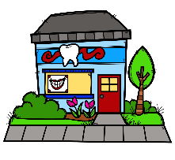


Read it!
I like the grapes.
We go to the dentist.
The pumpkin is big.

Slide 289

Move it!
Spell the word out loud and do a squat for every letter!
t
e
h
2016 Samantha Kelly

Slide 290
Share it!
Use the word the in a sentence.
Tell your neighbor.
2016 Samantha Kelly

Slide 291
Woohoo!
We know the word
the!

Slide 292
Let’s
learn a
word!

Slide 293
three
2016 Samantha Kelly

Slide 294
Spell it!
t
h
r
e
e
2016 Samantha Kelly

Slide 295
2
0
1
3
4
Find it!
5
Press space to start timer.
find
three
for
red
here
jump
three
me
and
2
How many?

Slide 296
Write it!
three
Write it on your hand.
Write it in the air.
2016 Samantha Kelly

Slide 297

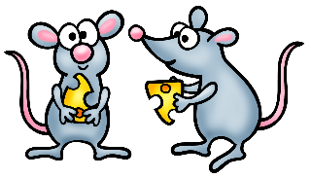

Read it!
We have three carrots.
I see three mice.
Three little frogs jump.

Slide 298

Move it!
Spell the word out loud and run in place for every letter!
r
e
h
t
e
2016 Samantha Kelly

Slide 299
Share it!
Use the word three in a sentence.
Tell your neighbor.
2016 Samantha Kelly

Slide 300
Woohoo!
We know the word
three!

Slide 301
Let’s
learn a
word!

Slide 302
to
2016 Samantha Kelly

Slide 303
Spell it!
o
t
2016 Samantha Kelly

Slide 304
2
0
1
3
4
Find it!
5
Press space to start timer.
to
away
big
to
little
to
in
to
to
can
to
find
6
How many?

Slide 305
to
Write it!
Write it on your hand.
Write it in the air.
2016 Samantha Kelly

Slide 306



Read it!
I like to ride.
Can I run to school?
We go to the beach.
2016 Samantha Kelly

Slide 307

Move it!
Spell the word out loud and do a jumping jack for every letter!
o
t
2016 Samantha Kelly

Slide 308
Share it!
Use the word to in a sentence.
Tell your neighbor.
2016 Samantha Kelly

Slide 309
Woohoo!
We know the word
to!

Slide 310
Let’s
learn a
word!

Slide 311
two
2016 Samantha Kelly

Slide 312
Spell it!
t
w
o
2016 Samantha Kelly

Slide 313
2
0
1
3
4
Find it!
5
Press space to start timer.
run
two
a
two
two
my
funny
here
two
little
4
How many?

Slide 314
Write it!
two
Write it on your hand.
Write it in the air.
2016 Samantha Kelly

Slide 315




Read it!
I have two ears.
You have two eyes.
Can you see two flies?

Slide 316

Move it!
Spell the word out loud and lunge for every letter!
w
t
o
2016 Samantha Kelly

Slide 317
Share it!
Use the word two in a sentence.
Tell your neighbor.
2016 Samantha Kelly

Slide 318
Woohoo!
We know the word
two!

Slide 319
Let’s
learn a
word!

Slide 320
up
2016 Samantha Kelly

Slide 321
Spell it!
u
p
2016 Samantha Kelly

Slide 322
2
0
1
3
4
Find it!
5
Press space to start timer.
jump
a
up
me
not
up
for
up
up
three
up
it
5
How many?

Slide 323
up
Write it!
Write it on your hand.
Write it in the air.
2016 Samantha Kelly

Slide 324




Read it!
I go up the ladder.
Look up in the clouds!
The rocket can go up.

Slide 325
Move it!
Spell the word out loud and touch your elbow to your knee for every letter!
p
u
2016 Samantha Kelly

Slide 326
Share it!
Use the word up in a sentence.
Tell your neighbor.
2016 Samantha Kelly

Slide 327
Woohoo!
We know the word
up!

Slide 328
Let’s
learn a
word!

Slide 329
we
2016 Samantha Kelly

Slide 330
Spell it!
w
e
2016 Samantha Kelly

Slide 331
2
0
1
3
4
Find it!
5
Press space to start timer.
one
we
red
I
we
down
here
for
help
we
to
3
How many?

Slide 332
we
Write it!
Write it on your hand.
Write it in the air.
2016 Samantha Kelly

Slide 333



Read it!
We like to swim.
We can play football.
We are on the bus.
2016 Samantha Kelly

Slide 334

Move it!
Spell the word out loud and do a push up for every letter!
w
e
2016 Samantha Kelly

Slide 335
Share it!
Use the word we in a sentence.
Tell your neighbor.
2016 Samantha Kelly

Slide 336
Woohoo!
We know the word
we!

Slide 337
Let’s
learn a
word!

Slide 338
where
2016 Samantha Kelly

Slide 339
Spell it!
w
h
e
r
e
2016 Samantha Kelly

Slide 340
2
0
1
3
4
Find it!
5
Press space to start timer.
not
where
red
play
down
look
blue
where
up
2
How many?

Slide 341
Write it!
where
Write it on your hand.
Write it in the air.
2016 Samantha Kelly

Slide 342



Read it!
Where is the blanket?
Where can I sit?
Where is my doll?
2016 Samantha Kelly

Slide 343

Move it!
Spell the word out loud and do a squat for every letter!
e
e
h
w
r
2016 Samantha Kelly

Slide 344
Share it!
Use the word where in a sentence.
Tell your neighbor.
2016 Samantha Kelly

Slide 345
Woohoo!
We know the word
where!

Slide 346
Let’s
learn a
word!

Slide 347
yellow
2016 Samantha Kelly

Slide 348
Spell it!
y
e
l
l
o
w
2016 Samantha Kelly

Slide 349
2
0
1
3
4
Find it!
5
Press space to start timer.
make
it
yellow
yellow
big
two
three
yellow
a
3
How many?

Slide 350
Write it!
yellow
Write it on your hand.
Write it in the air.
2016 Samantha Kelly

Slide 351



Read it!
I see the yellow sun!
A lemon is yellow.
Is the banana yellow?
2016 Samantha Kelly

Slide 352

Move it!
Spell the word out loud and run in place for every letter!
l
l
e
w
y
o
2016 Samantha Kelly

Slide 353
Share it!
Use the word yellow in a sentence.
Tell your neighbor.
2016 Samantha Kelly

Slide 354
Woohoo!
We know the word
yellow!

Slide 355
Let’s
learn a
word!

Slide 356
you
2016 Samantha Kelly

Slide 357
Spell it!
y
o
u
2016 Samantha Kelly

Slide 358
2
0
1
3
4
Find it!
5
Press space to start timer.
come
find
you
you
two
you
it
and
you
where
4
How many?

Slide 359
you
Write it!
Write it on your hand.
Write it in the air.
2016 Samantha Kelly

Slide 360



Read it!
You are my friend.
Do you like chips?
Can I hug you?
2016 Samantha Kelly

Slide 361

Move it!
Spell the word out loud and do a jumping jack for every letter!
y
u
o
2016 Samantha Kelly

Slide 362
Share it!
Use the word you in a sentence.
Tell your neighbor.
2016 Samantha Kelly

Slide 363
Woohoo!
We know the word
you!

Slide 364


